Slide 1
The Battle of Neighborhoods

Slide 2
Introduction
Lin will be assigned to oversea as a contactor of his company for three months. He has to decide which city he may locate from Toronto, Paris and New York. Because it'll be a long term trip to North America and he likes Asian food very much, so he wants to know which city is better for his travel. That means which city has a high-quantity and high-quality Asian cuisine restaurant. He managed to compare the neighborhoods of the two cities and determine how similar or dissimilar they are before his travel, And then he can get more helpful information for him making decisions.

Slide 3
Data section
Foursquare API is used to fetch and explore neighborhood data of those three cities. The information he wants to focus on is restaurants. He will choose the city's coordinate as the start point. Analyzing the neighborhood data and prioritize the best restaurant location in those three cities based on the number of restaurants, average distance, and average rate. Lastly, he can decide which city is the better place for him to get start.

Slide 4
Methodology
Search for a specific venue category
Explore a Given Venue

Slide 5
Results
There are results I derived from the Foursquare API. It seems that New York City has less restaurant, but close distance and high rate; Paris has far distance; Toronto has more restaurant but low rate. The following here are the pictures of the geoplot generated with folium.
city | restaurants | AVG Distance | AVG Rate
New York | 12 | 0.009169 | 7.333333
Paris | 15 | 0.026685 | 6.900000
Toronto | 19 | 0.021244 | 6.566667

Slide 6
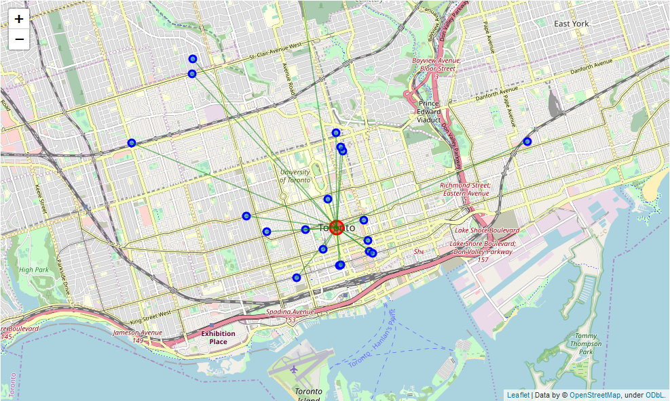
Let's visualize the Asian restaurants that are nearby - Toronto

Slide 7
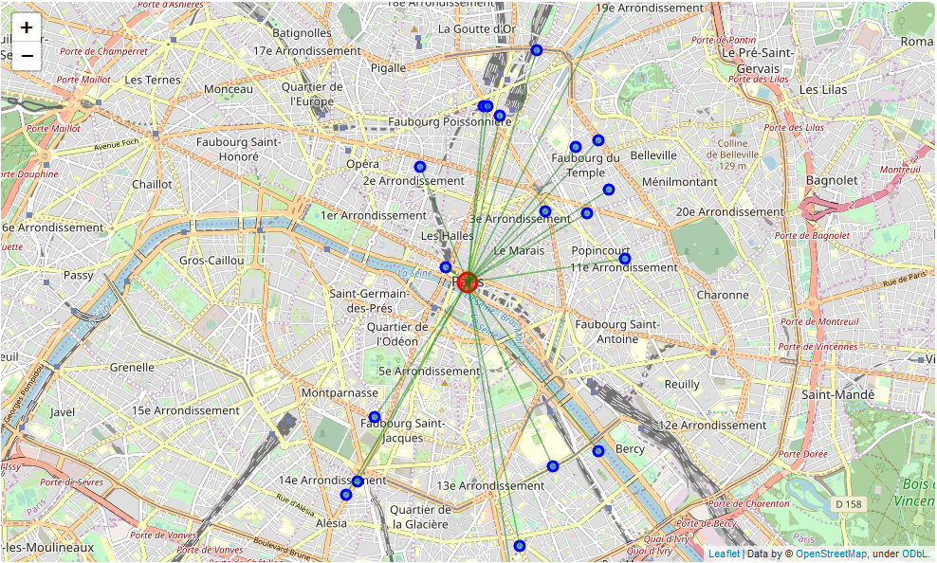
Let's visualize the Asian restaurants that are nearby - Paris

Slide 8
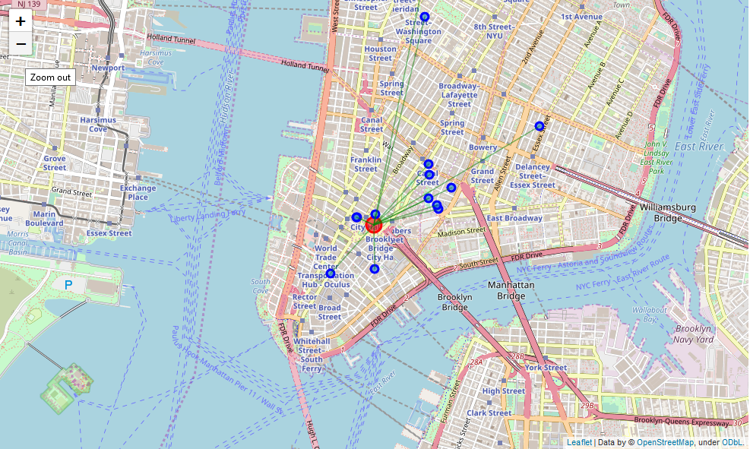
Let's visualize the Asian restaurants that are nearby – New York

Slide 9
Discussion
During the data exploration, Some returned data from the Foursquare API is incomplete. E.g. incorrect city name，missing address and no rating. These kinds of data are excluded from this analysis. The average rate only bases on the restaurants which have a rate.

Slide 10
Conclusion
Although there are fewest restaurants in New York City, I think Lin will choose New York City as his destination because of close distance and a high rate. Please be aware of this analysis base on the city coordinates as the start point. If he decided his residence, he may update the coordinates to explore again.

